Slide 1

Introduction to Probability and Statistics
Twelfth Edition
Robert J. Beaver • Barbara M. Beaver • William Mendenhall
Presentation designed and written by:
Barbara M. Beaver

Slide 2
Introduction to Probability and Statistics
Twelfth Edition
Chapter 15
Nonparametric Statistics
Some graphic screen captures from Seeing Statistics ®
Some images © 2001-(current year) www.arttoday.com

Slide 3
What are
Nonparametric Statistics?
In all of the preceding chapters we have focused on testing and estimating parameters associated with distributions.
In this chapter we will focus on questions such as:
  Do two distributions have the same center?
  Do two distributions have the same shape?

Slide 4
Why Use
Nonparametric Statistics?
Parametric tests are based upon assumptions that may include the following:
  The data have the same variance, regardless of the treatments or conditions in the experiment.
  The data are normally distributed for each of the treatments or conditions in the experiment.
What happens when we are not sure that these assumptions have been satisfied?

Slide 5
How Do Nonparametric Tests Compare with the Usual z, t, and F Tests?
Studies have shown that when the usual assumptions are satisfied, nonparametric tests are about 95% efficient when compared to their parametric equivalents.
When normality and common variance are not satisfied, the nonparametric procedures can be much more efficient than their parametric equivalents.

Slide 6
The Wilcoxon Rank Sum Test
Suppose we wish to test the hypothesis that two distributions have the same center.
We select two independent random samples from each population. Designate each of the observations from population 1 as an “A” and each of the observations from population 2 as a “B”.
If H₀ is true, and the two samples have been drawn from the same population, when we rank the values in both samples from small to large, the A’s and B’s should be randomly mixed in the rankings.

Slide 7
What happens when H₀ is true?
Suppose we had 5 measurements from population 1 and 6 measurements from population 2.
If they were drawn from the same population, the rankings might be like this.
ABABBABABBA
In this case if we summed the ranks of the A measurements and the ranks of the B measurements, the sums would be similar.

Slide 8
What happens if H₀ is not true?
If the observations come from two different populations, perhaps with population 1 lying to the left of population 2, the ranking of the observations might take the following ordering.
AAABABABBB
In this case the sum of the ranks of the B observations would be larger than that for the A observations.

Slide 9
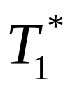
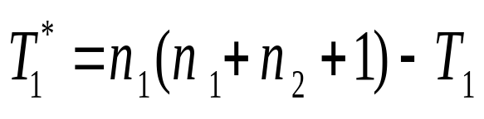
How to Implement Wilcoxon’s Rank Test
Rank the combined sample from smallest to largest.
Let T₁ represent the sum of the ranks of the first sample (A’s).
Then, defined below, is the sum of the ranks that the A’s would have had if the observations were ranked from large to small.

Slide 10
The Wilcoxon Rank Sum Test
H₀: the two population distributions are the same
H_{a}: the two populations are in some way different
The test statistic is the smaller of T₁ and T₁*.
Reject H₀ if the test statistic is less than the critical value found in Table 7(a).
Table 7(a) is indexed by letting population 1 be the one associated with the smaller sample size n₁, and population 2 as the one associated with n_{2,} the larger sample size.

Slide 11

Example
The wing stroke frequencies of two
species of bees were recorded for a sample of n₁ = 4 from species 1 and n₂ = 6 from species 2. Can you conclude that the distributions of wing strokes differ for these two species? Use α = .05.
If several measurements are tied, each gets the average of the ranks they would have gotten, if they were not tied! (See x = 180)
H₀: the two species are the same
H_{a}: the two species are in some way different
Species 1 | Species 2
235 | 180
225 | 169
190 | 180
188 | 185
 | 178
 | 182
(10)
(3.5)
The sample with the smaller sample size is called sample 1.
We rank the 10 observations from smallest to largest, shown in parentheses in the table.
(9)
(1)
(8)
(3.5)
(7)
(6)
(2)
(5)

Slide 12
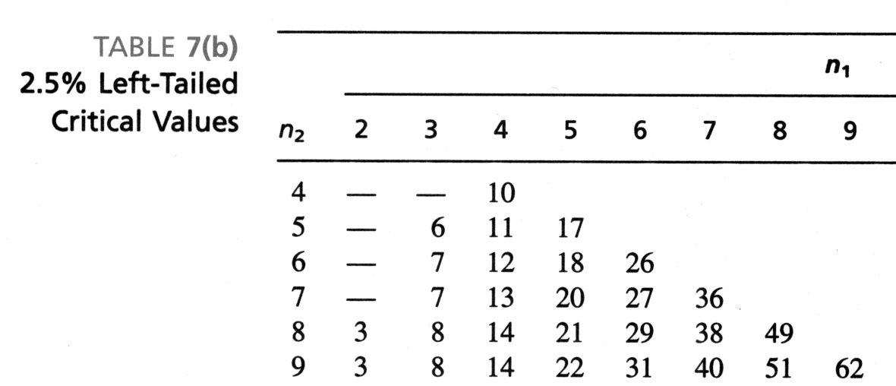
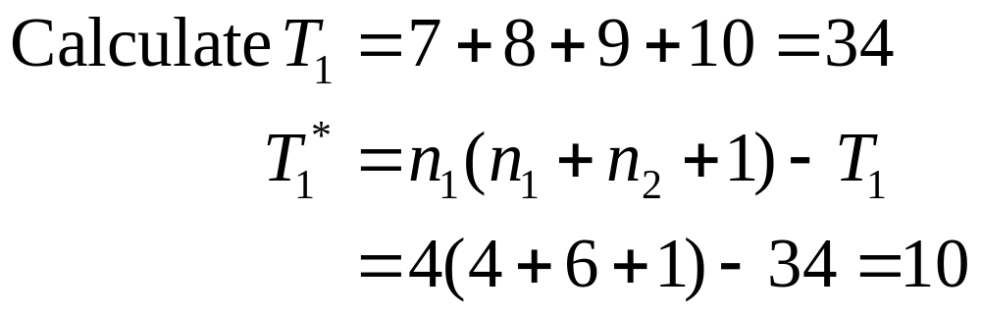
The Bee Problem
Can you conclude that the distributions
of wing strokes differ for these two species? α = .05.
Do not reject H₀. Insufficient evidence to indicate a difference in the distributions of wing stroke frequencies.
Species 1 | Species 2
235 | 180
225 | 169
190 | 180
188 | 185
 | 178
 | 182
(10)
(3.5)
(9)
(1)
(8)
(3.5)
(7)
(6)
(2)
The test statistic is T = 10.
The critical value of T from Table 7(b) for a two-tailed test with α/2 = .025 is T = 12; H₀ is rejected if T ≤ 12.
(5)

Slide 13
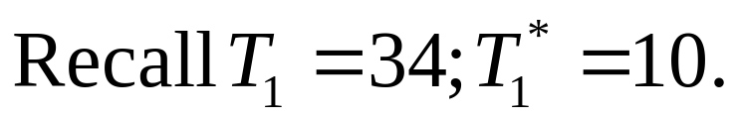
Minitab Output
Mann-Whitney Test and CI: Species1, Species2
N Median
Species 1 4 207.50
Species 2 6 180.00
Point estimate for ETA1-ETA2 is 30.50
95.7 Percent CI for ETA1-ETA2 is (5.99,56.01)
W = 34.0
Test of ETA1 = ETA2 vs ETA1 not = ETA2 is significant at 0.0142
The test is significant at 0.0139 (adjusted for ties)
Minitab calls the procedure the Mann-Whitney U Test, equivalent to the Wilcoxon Rank Sum Test.
The test statistic is W = T₁ = 34 and has p-value = .0142. Do not reject H₀ for α = .05.

Slide 14
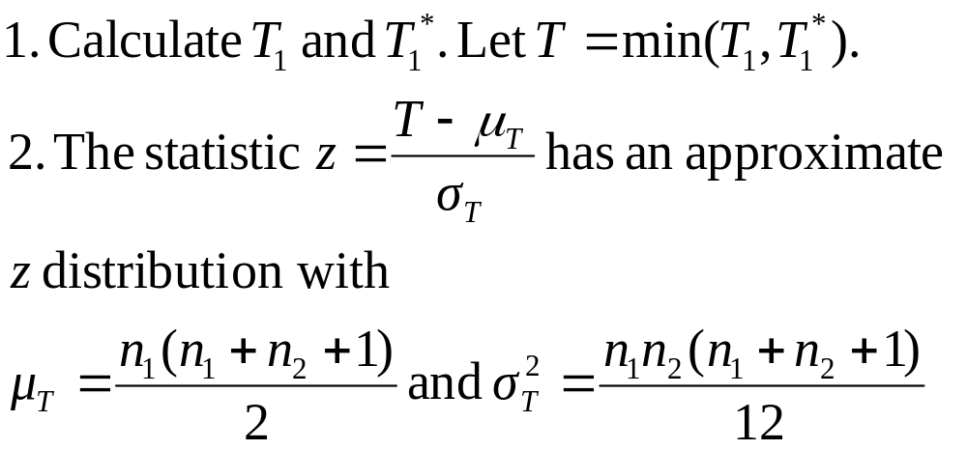
Large Sample Approximation:
Wilcoxon Rank Sum Test
When n₁ and n₂ are large (greater than 10 is large enough), a normal approximation can be used to approximate the critical values in Table 7.

Slide 15
Some Notes
When should you use the Wilcoxon Rank Sum test instead of the two-sample t test for independent samples?
  when the responses can only be ranked and not quantified
  when the F test or the Rule of Thumb shows a problem with equality of variances
  when a normality plot shows a violation of the normality assumption

Slide 16

The Sign Test
The sign test is a fairly simple
procedure that can be used to compare two populations when the samples consist of paired observations.
It can be used
  when the assumptions required for the paired-difference test of Chapter 10 are not valid or
  when the responses can only be ranked as “one better than the other”, but cannot be quantified.

Slide 17
The Sign Test
For each pair, measure whether the first response—say, A—exceeds the second response—say, B.
The test statistic is x, the number of times that A exceeds B in the n pairs of observations.
Only pairs without ties are included in the test.
Critical values for the rejection region or exact p-values can be found using the cumulative binomial tables in Appendix I.

Slide 18
The Sign Test
H₀: the two populations are identical versus
H_{a}: one or two-tailed alternative
is equivalent to
H₀: p = P(A exceeds B) = .5 versus
H_{a}: p (≠, <, or >) .5
Test statistic: x = number of plus signs
Rejection region or p-values from Table 1.

Slide 19
Example
Two gourmet chefs each tasted and rated
eight different meals from 1 to 10. Does it appear that one of the chefs tends to give higher ratings than the other? Use α = .01.
Meal | 1 | 2 | 3 | 4 | 5 | 6 | 7 | 8
Chef A | 6 | 4 | 7 | 8 | 2 | 4 | 9 | 7
Chef B | 8 | 5 | 4 | 7 | 3 | 7 | 9 | 8
Sign | - | - | + | + | - | - | 0 | -
H₀: the rating distributions are the same (p = .5)
H_{a}: the ratings are different (p ≠ .5)

Slide 20
The Gourmet Chefs
Meal | 1 | 2 | 3 | 4 | 5 | 6 | 7 | 8
Chef A | 6 | 4 | 7 | 8 | 2 | 4 | 9 | 7
Chef B | 8 | 5 | 4 | 7 | 3 | 7 | 9 | 8
Sign | - | - | + | + | - | - | 0 | -
p-value =.454 is too large to reject H₀. There is insufficient evidence to indicate that one chef tends to rate one meal higher than the other.
H₀: p = .5
H_{a}: p ≠ .5 with n = 7 (omit the tied pair)
Test Statistic: x = number of plus signs = 2
Use Table 1 with n = 7 and p = .5.
p-value = P(observe x = 2 or something equally as unlikely)
= P(x ≤ 2) + P(x ≥ 5) = 2(.227) = .454
k | 0 | 1 | 2 | 3 | 4 | 5 | 6 | 7
P(x ≤ k) | .008 | .062 | .227 | .500 | .773 | .938 | .992 | 1.000

Slide 21
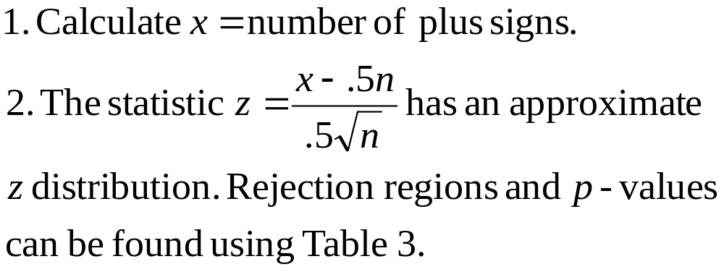
Large Sample Approximation:
The Sign Test
When n ≥ 25, a normal approximation can be used to approximate the critical values in Table 1.

Slide 22

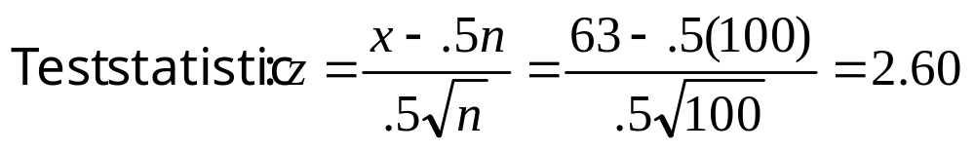
Example
You record the number of accidents per day at a large manufacturing plant for both the day and evening shifts for n = 100 days. You find that the number of accidents per day for the evening shift x_{E} exceeded the corresponding number of accidents in the day shift x_{D} on 63 of the 100 days. Do these results provide sufficient evidence to indicate that more accidents tend to occur on one shift than on the other?
For a two tailed test, we reject H₀ if |z| > 1.96 (5% level).
H₀ is rejected. There is evidence of a difference between the day and night shifts.
H₀: the distributions (# of accidents) are the same (p = .5)
H_{a}: the distributions are different (p ≠ .5)

Slide 23
Which test should you use?
We compare statistical tests using
Definition: Power = 1 − β
= P(reject H₀ when H_{a} is true)
The power of the test is the probability of rejecting the null hypothesis when it is false and some specified alternative is true.
The power is the probability that the test will do what it was designed to do—that is, detect a departure from the null hypothesis when a departure exists.

Slide 24
Which test should you use?
If all parametric assumptions have been met, the parametric test will be the most powerful.
If not, a nonparametric test may be more powerful.
If you can reject H₀ with a less powerful nonparametric test, you will not have to worry about parametric assumptions.
If not, you might try
  more powerful nonparametric test or
  increasing the sample size to gain more power

Slide 25

The Wilcoxon Signed-Rank Test
The Wilcoxon Signed-Rank Test is a more powerful nonparametric procedure that can be used to compare two populations when the samples consist of paired observations.
It uses the ranks of the differences, d = x₁-x₂ that we used in the paired-difference test.

Slide 26
The Wilcoxon Signed-Rank Test
For each pair, calculate the difference d = x₁-x₂. Eliminate zero differences.
Rank the absolute values of the differences from 1 to n. Tied observations are assigned average of the ranks they would have gotten if not tied.
  T⁺ = rank sum for positive differences
  T⁻ = rank sum for negative differences
If the two populations are the same, T⁺ and T⁻ should be nearly equal. If either T⁺ or T⁻ is unusually large, this provides evidence against the null hypothesis.

Slide 27
The Wilcoxon Signed-Rank Test
H₀: the two populations are identical versus
H_{a}: one or two-tailed alternative
Test statistic: T = smaller of T⁺ and T⁻
Critical values for a one or two-tailed rejection region can be found using Table 8 in Appendix I.

Slide 28
Example
To compare the densities of cakes using
mixes A and B, six pairs of pans (A and B) were baked side-by-side in six different oven locations. Is there evidence of a difference in density for the two cake mixes?
Location | 1 | 2 | 3 | 4 | 5 | 6
Cake Mix A | .135 | .102 | .098 | .141 | .131 | .144
Cake Mix B | .129 | .120 | .112 | .152 | .135 | .163
d = x_{A}-x_{B} | .006 | -.018 | -.014 | -.011 | -.004 | -.019
H₀: the density distributions are the same
H_{a}: the density distributions are different

Slide 29
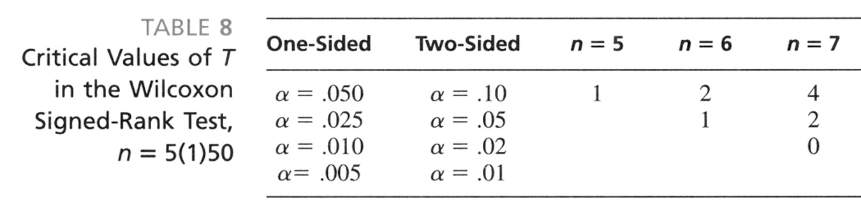
Cake Densities
Location | 1 | 2 | 3 | 4 | 5 | 6
Cake Mix A | .135 | .102 | .098 | .141 | .131 | .144
Cake Mix B | .129 | .120 | .112 | .152 | .135 | .163
d = x_{A}-x_{B} | .006 | -.018 | -.014 | -.011 | -.004 | -.019
Rank | 2 | 5 | 4 | 3 | 1 | 6
Do not reject H₀. There is insufficient evidence to indicate that there is a difference in densities for the two cake mixes.
Calculate: T⁺ = 2 and T⁻ = 5+4+3+1+6 = 19.
The test statistic is T = 2.
Rejection region: Use Table 8. For a two-tailed test with α = .05, reject H₀ if T ≤ 1.
Rank the 6 differences, without regard to sign.

Slide 30
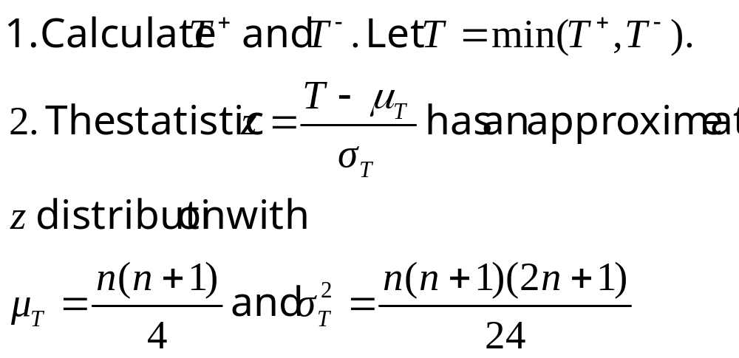
Large Sample Approximation:
The Signed-Rank Test
When n ≥ 25, a normal approximation can be used to approximate the critical values in Table 8.

Slide 31

The Kruskal-Wallis H Test
The Kruskal-Wallis H Test is a nonparametric procedure that can be used to compare more than two populations in a completely randomized design.
All n = n₁+n₂+…+n_{k} measurements are jointly ranked.
We use the sums of the ranks of the k samples to compare the distributions.

Slide 32
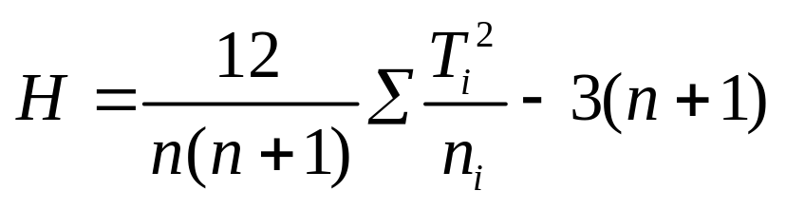
The Kruskal-Wallis H Test
Rank the total measurements in all k samples
from 1 to n. Tied observations are assigned average of the ranks they would have gotten if not tied.
Calculate
  T_{i} = rank sum for the ith sample i = 1, 2,…,k
And the test statistic

Slide 33
The Kruskal-Wallis H Test
H₀: the k distributions are identical versus
H_{a}: at least one distribution is different
Test statistic: Kruskal-Wallis H
When H₀ is true, the test statistic H has an approximate chi-square distribution with df = k-1.
Use a right-tailed rejection region or p-value based on the Chi-square distribution.

Slide 34
Example
Four groups of students were randomly
assigned to be taught with four different techniques, and their achievement test scores were recorded. Are the distributions of test scores the same, or do they differ in location?
1 | 2 | 3 | 4
65 | 75 | 59 | 94
87 | 69 | 78 | 89
73 | 83 | 67 | 80
79 | 81 | 62 | 88

Slide 35
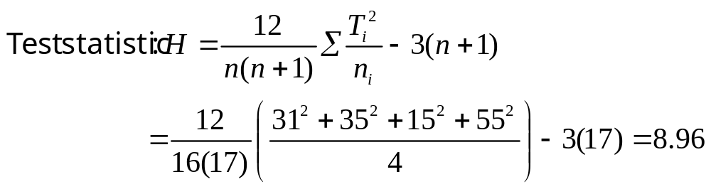
Teaching Methods
 | 1 | 2 | 3 | 4
 | 65 | 75 | 59 | 94
 | 87 | 69 | 78 | 89
 | 73 | 83 | 67 | 80
 | 79 | 81 | 62 | 88
 | (3) | (7) | (1) | (16)
 | (13) | (5) | (8) | (15)
 | (6) | (12) | (4) | (10)
 | (9) | (11) | (2) | (14)
T_{i} | 31 | 35 | 15 | 55
Rank the 16 measurements from 1 to 16, and calculate the four rank sums.
H₀: the distributions of scores are the same
H_{a}: the distributions differ in location

Slide 36
Teaching Methods
H₀: the distributions of scores are the same
H_{a}: the distributions differ in location
Reject H₀. There is sufficient evidence to indicate that there is a difference in test scores for the four teaching techniques.
Rejection region: Use Table 5. For a right-tailed chi-square test with α = .05 and df = 4-1 =3, reject H₀ if H ≥ 7.81.

Slide 37

The Friedman F_{r} Test
The Friedman F_{r} Test is the nonparametric equivalent of the randomized block design with k treatments and b blocks.
All k measurements within a block are ranked from 1 to b.
We use the sums of the ranks of the k treatment observations to compare the k treatment distributions.

Slide 38
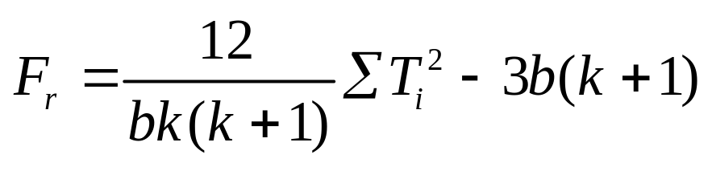
The Friedman F_{r} Test
Rank the k measurements within each block from
from 1 to k. Tied observations are assigned average of the ranks they would have gotten if not tied.
Calculate
  T_{i} = rank sum for the ith treatment i = 1, 2,…,k
and the test statistic

Slide 39
The Friedman F_{r} Test
H₀: the k treatments are identical versus
H_{a}: at least one distribution is different
Test statistic: Friedman F_{r}
When H₀ is true, the test statistic F_{r} has an approximate chi-square distribution with df = k-1.
Use a right-tailed rejection region or p-value based on the Chi-square distribution.

Slide 40
Example
A student is subjected to a stimulus and
we measure the time until the student reacts
by pressing a button. Four students are used in the experiment, each is subjected to three stimuli, and their reaction times are measured. Do the distributions of reaction times differ for the three stimuli?
 | Stimuli
Subject | 1 | 2 | 3
1 | .6 | .9 | .8
2 | .7 | 1.1 | .7
3 | .9 | 1.3 | 1.0
4 | .5 | .7 | .8

Slide 41
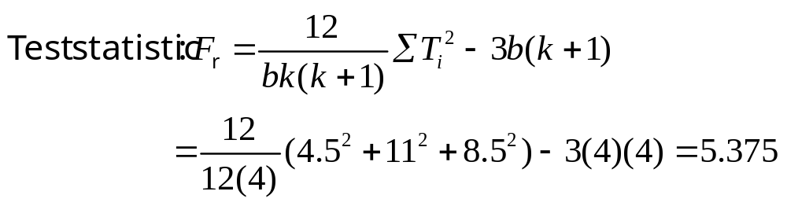
Reaction Times
 | Stimuli
Subject | 1 | 2 | 3
1 | .6 | .9 | .8
2 | .7 | 1.1 | .7
3 | .9 | 1.3 | 1.0
4 | .5 | .7 | .8
 | (1) | (3) | (2)
 | (1.5) | (3) | (1.5)
 | (1) | (3) | (2)
 | (1) | (2) | (3)
T_{i} | 4.5 | 11 | 8.5
Rank the 3 measurements for each subject from 1 to 3, and calculate the three rank sums.
H₀: the distributions of reaction times are the same
H_{a}: the distributions differ in location

Slide 42
Reaction Times
H₀: the distributions of reaction times are the same
H_{a}: the distributions differ in location
Do not reject H₀. There is insufficient evidence to indicate that there is a difference in reaction times for the three stimuli.
Rejection region: Use Table 5. For a right-tailed chi-square test with α = .05 and df = 3-1 =2, reject H₀ if H ≥ 5.99.

Slide 43

Rank Correlation Coefficient
The rank correlation coefficient, Spearman r_{s} is the nonparametric equivalent of the Pearson correlation coefficient r from Chapters 3 and 12.
The two variables are each ranked from smallest to largest and the ranks are denoted as x and y.
We are interested in the strength of the relationship (correlation) between the two variables.

Slide 44
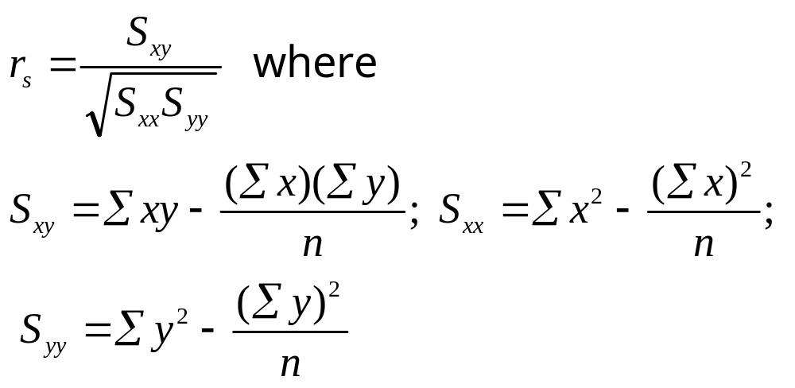
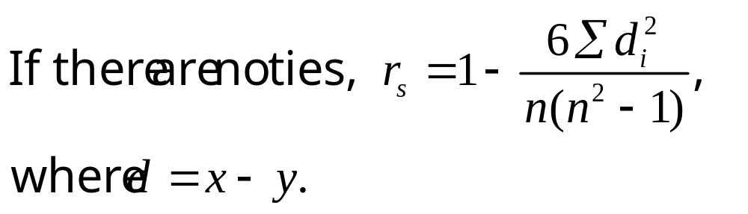
Rank Correlation Coefficient

Slide 45
Rank Correlation Coefficient
H₀: no association between the rank pairs
H_{a}: one or two-tailed alternative
Test statistic: r_{s}
Critical values for a one or two-tailed rejection region can be found using Table 9 in Appendix I.

Slide 46
Example
Five elementary school science teachers
have been ranked by a judge according to their teaching ability. They have also taken a national “teacher’s exam”. Is there agreement between the judge’s rank and the exam score?
Teacher | 1 | 2 | 3 | 4 | 5
Judge’s Rank | 4 | 2 | 3 | 1 | 5
Exam score | 72 | 69 | 82 | 93 | 80
If the judge’s rank is low (best teacher), we might expect the teacher’s score to be high. We look for a negative association between the ranked measurements.

Slide 47
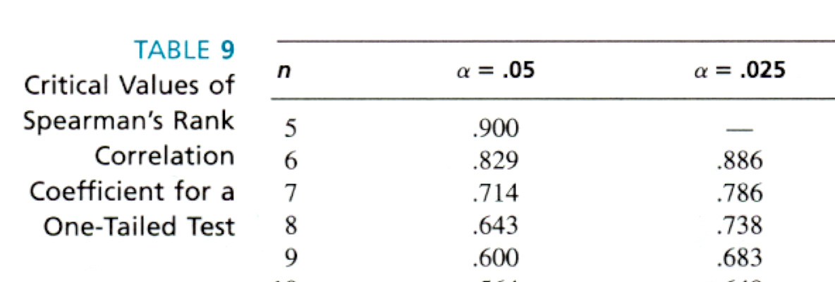
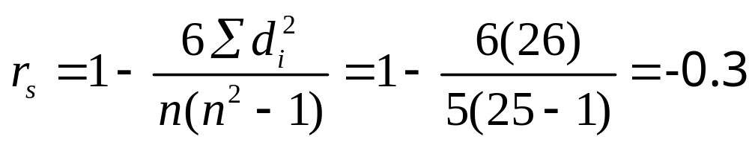
Example
Teacher | 1 | 2 | 3 | 4 | 5
Judge’s Rank | 4 | 2 | 3 | 1 | 5
Exam score | 72 | 69 | 82 | 93 | 80
For a one-tailed test with α = .05 and n = 5, reject H₀ if r_{s} ≥ .900. We do not reject H₀. Not enough evidence to indicate a negative association.
d | 2 | 1 | -1 | -4 | 2
Teacher | 1 | 2 | 3 | 4 | 5
x | 4 | 2 | 3 | 1 | 5
y | 2 | 1 | 4 | 5 | 3
Rank the exam scores (the first variable is already in rank form). There are no ties.

Slide 48
Summary
The nonparametric analogues of the parametric
procedures presented in Chapters 10–14 are
straightforward and fairly simple to implement.
The Wilcoxon rank sum test is the nonparametric analogue of the two-sample t test.
The sign test and the Wilcoxon signed-rank test are the nonparametric analogues of the paired-sample t test.
The Kruskal-Wallis H test is the rank equivalent of the one- way analysis of variance F test.
The Friedman F_{r} test is the rank equivalent of the randomized block design two-way analysis of variance F test.
Spearman's rank correlation r_{s} is the rank equivalent of
Pearson’s correlation coefficient.

Slide 49
Key Concepts
I. Nonparametric Methods
1. These methods can be used when the data cannot be measured on a quantitative scale, or when
The numerical scale of measurement is arbitrarily set by the
researcher, or when
The parametric assumptions such as normality or constant
variance are seriously violated.
II. Wilcoxon Rank Sum Test: Independent Random Samples
1. Jointly rank the two samples: Designate the smaller sample as sample 1. Then

Slide 50

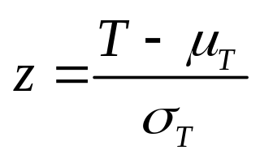
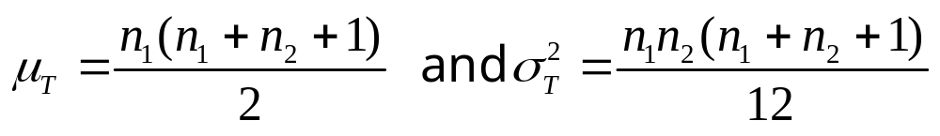
Key Concepts
2. Use T₁ to test for population 1 to the left of population 2
Use to test for population to the right of population 2.
Use the smaller of T₁ and to test for a difference in the locations of the two populations.
3. Table 7 of Appendix I has critical values for the rejection
of H₀.
4. When the sample sizes are large, use the normal
approximation:

Slide 51
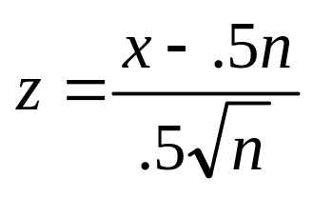
Key Concepts
III. Sign Test for a Paired Experiment
1. Find x, the number of times that observation A exceeds observation B for a given pair.
2. To test for a difference in two populations, test H₀ : p = 0.5 versus a one- or two-tailed alternative.
3. Use Table 1 of Appendix I to calculate the p-value for the test.
4. When the sample sizes are large, use the normal
approximation:

Slide 52
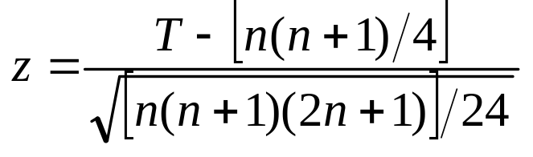
Key Concepts
IV. Wilcoxon Signed-Rank Test: Paired Experiment
1. Calculate the differences in the paired observations. Rank
the absolute values of the differences. Calculate the rank
sums T ⁻ and T ⁺ for the positive and negative differences,
respectively. The test statistic T is the smaller of the two rank
sums.
2. Table 8 of Appendix I has critical values for the rejection of
for both one- and two-tailed tests.
3. When the sampling sizes are large, use the normal
approximation:

Slide 53
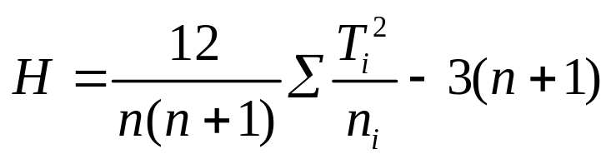
Key Concepts
V. Kruskal-Wallis H Test: Completely Randomized Design
1. Jointly rank the n observations in the k samples. Calculate the rank sums, T_{i} = rank sum of sample i, and the test statistic
2. If the null hypothesis of equality of distributions is false, H will be unusually large, resulting in a one-tailed test.
3. For sample sizes of five or greater, the rejection region for H is based on the chi-square distribution with (k − 1) degrees of freedom.

Slide 54
Key Concepts
VI. The Friedman F_{r} Test: Randomized Block Design
1. Rank the responses within each block from 1 to k. Calculate the rank sums T₁, T₂, …, T_{k}, and the test statistic
2. If the null hypothesis of equality of treatment distributions is false, F_{r} will be unusually large, resulting in a one-tailed test.
3. For block sizes of five or greater, the rejection region for F_{r} is based on the chi-square distribution with (k − 1) degrees of freedom.

Slide 55
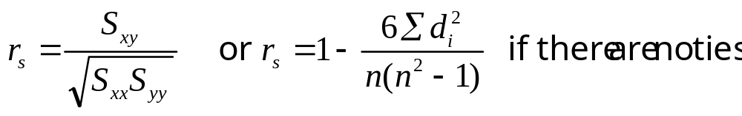
Key Concepts
VII. Spearman's Rank Correlation Coefficient
1. Rank the responses for the two variables from smallest to largest.
2. Calculate the correlation coefficient for the ranked
observations:
Table 9 in Appendix I gives critical values for rank correlations significantly different from 0.
The rank correlation coefficient detects not only significant linear correlation but also any other monotonic relationship between the two variables.

